Slide 1
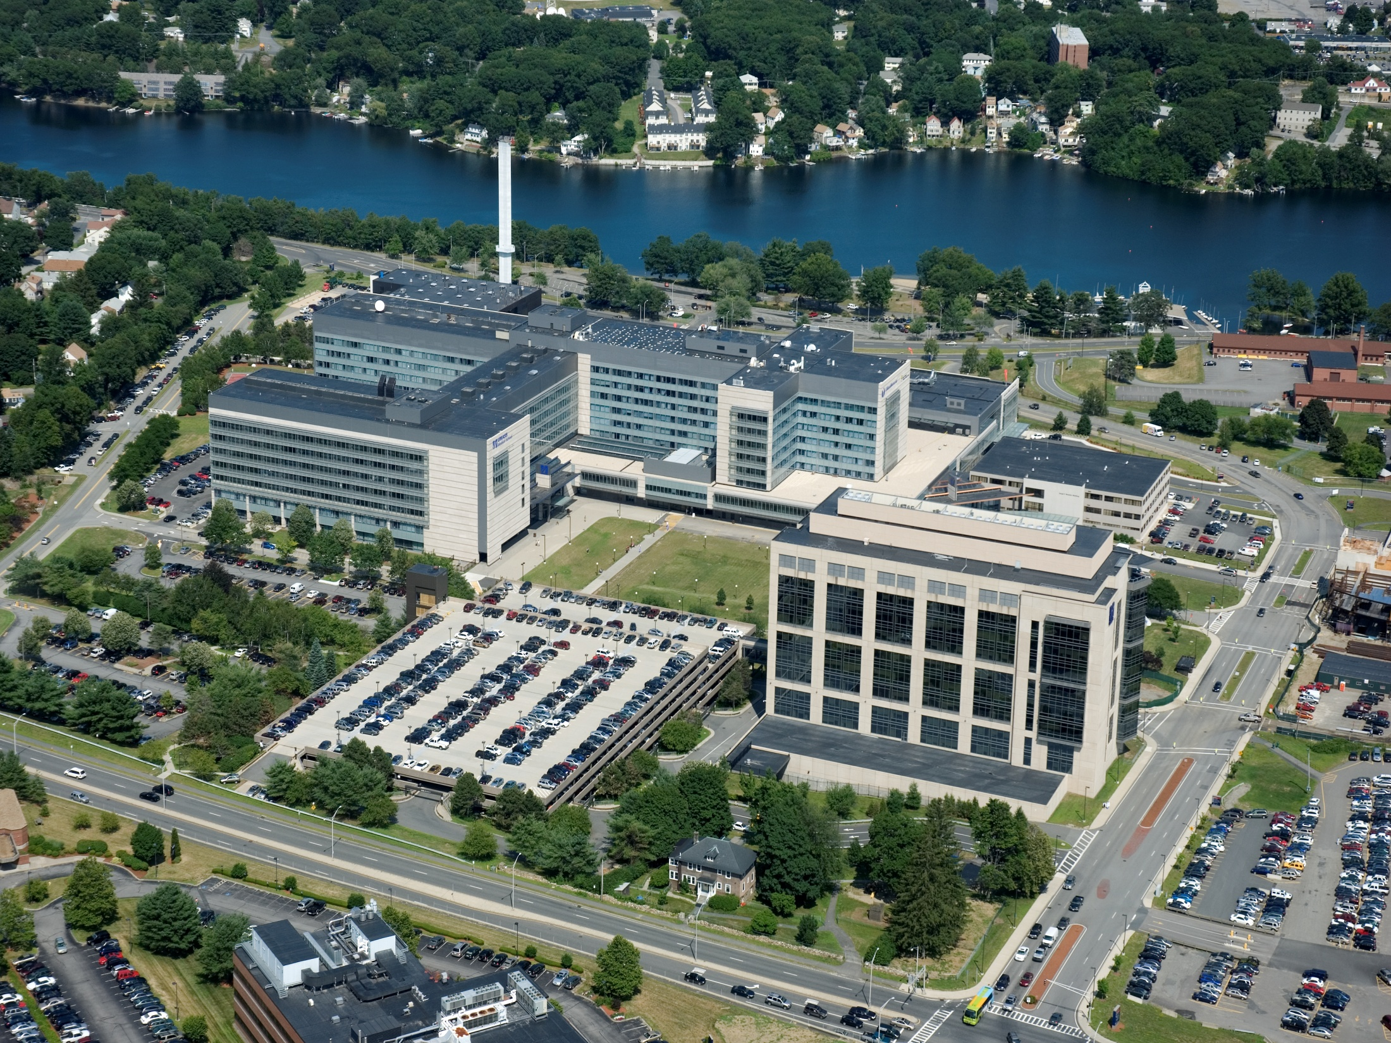
Educational Effort Assignment Task Force Update
Faculty Council
May 6, 2010 Michele P. Pugnaire, MD
Tony Carruthers, PhD
Notes:
To Edit the Date go to View> Slide Master
On the Title Slide Master, select the text box with the date and edit.

Slide 2
Overview EEATF
Background Rationale
Timing is right and aligned with institution-wide trends:
Departmental incentive and compensation plans that require weighting according to effort assignment.
Expansion of class size in the three schools and residencies with the need to monitor/support teaching effort and projected needs.
Curriculum revision in all three schools, with integration and interdisciplinary collaboration, distributing educational effort across a broader range of faculty and departments.

Slide 3
Dean’s Charge
Establish a consistent and comprehensive methodology for assignment of effort for teaching activities by faculty in our diverse educational programs.
Notables about the report:
  Not a policy statement, is advisory to the Dean.
  To inform the Dean in aligning educational effort with school resources
  Determination of funds allocation will not be part of the report and will reside under the authority of the Dean and the Office of A&F

Slide 4
Scope of Educational Mission
All learner groups enrolled in accredited UMMS educational courses, degree programs and training programs.
Excludes learners in K-12 outreach programs, undergraduate students in pipeline and related programs, and visiting students and trainees enrolled in electives or other school-sponsored educational programs.

Slide 5
Scope of Learner Groups
EEATF Recommendations will apply to the following learner groups:
  School of Medicine Undergraduate Medical Education (UME) preclinical and clinical students.
  School of Medicine Graduate Medical Education (GME): residents and fellows in accredited programs.
  Graduate School of Biomedical Sciences (GSBS): graduate students.
  Graduate School of Biomedical Sciences (GSBS): Post-doctoral trainees.
While task force membership includes the GSN, its recommendations will not apply to GSN students.

Slide 6
Scope of “Educational Activities”
Three major domains of education effort:
  Class room based effort: ed effort not associated with billable clinical work, research activities, or other compensated activity.
    EG: Lectures, small groups, seminars, skills sessions
  Practice-based effort: ed effort associated with billable clinical work, research activities, or other compensated work activity.
    EG: out-patient clinic precepting, in-pt hospital ward teaching, research lab-based teaching
  Educational Leadership: major administrative and leadership positions specifically assigned to an educational program.
    EG: course /clerkship director, block head, program director, thesis director
Notes:
Education-related activities that are considered as “educational service” as opposed to “formal teaching effort”:
Admissions committee service /interviews
Informal mentoring /advising
Non-leadership roles for EPC and graduate council and other standing committees
Membership on ad hoc task forces; accreditation task forces, etc
Non-accredited elective programs such as the optional enrichment electives
Educational effort serving non-UMMS students such as visiting students and trainees
Note: Leadership roles directly supported by school funds and reporting to the dean’s office are also excluded from the Task force recommendations.

Slide 7
Not In Scope
Education-related activities that are considered as “educational service” as opposed to “formal teaching effort”:
  Admissions committee service /interviews
  Informal mentoring /advising
  Non-leadership roles for EPC and graduate council and other standing committees
  Membership on ad hoc task forces; accreditation task forces, etc
  Non-accredited elective programs such as the optional enrichment electives
  Educational effort serving non-UMMS students such as visiting students and trainees
Note: Leadership roles directly supported by school funds and reporting to the dean’s office are also excluded from the Task force recommendations.

Slide 8
EEATF Operating Principles
Inclusiveness : One set of recommendations across the range of learners and activities
Flexibility: Adaptable to programs across departments
Not starting from scratch: Applying practices/models in place at UMMS and elsewhere
User friendly: Ease of implementation and streamlined application of recommendations.
Data based reporting: Data driven, preferably automated, minimizing self–report
Evidence-Driven: Applying national guidelines or benchmarks, as available.
80/20 rule: “we can’t measure everything”, maintain focus on priority areas
Consistency: Compatibility with standards currently in place at UMMS:
    RRC guidelines, GSN guidelines, School’s Faculty Incentive Compensation Guidelines , OFA’s personnel policies and guidelines for appointment and promotion.
Quality of teaching: “quality” of educational effort is an important, independent measure of faculty teaching effort.

Slide 9
EEATF membership
The task force membership: Broad and inclusive
22 individuals representing institutional and departmental leadership, and faculty with experience across diverse educational programs and courses.
Members representing:
  SoM, GSBS, GSN, GME, Post Doc Program,
  Dept Chairs(Basic & Clinical); Group Practice Plan
  OFA, Faculty Council, EPC, Grad Council
Notes:
Members representing:
SoM, GSBS, GSN, GME, OFA, post Doc Program,
Dept Chairs( Basic&Clinical) ; Group Practice Plan, Faculty Council, EPC, Grad Council

Slide 10
EEATF Table of Organization and Reporting
Provost
Dean
Communication to key leadership groups
Chairs Council
Leadership Council
Faculty council
EPC
Graduate Council
GMEC
other
Educational Effort Task Force
Co-Chairs: Pugnaire, Carruthers
Project Manager and Admin Support
Paulette Goeden
John Ryan
Work Group 1
Classroom based Activity
Work Group2
Practice based Activity
Work Group 3
Ed leadership
Roles
Co-chairs:
Ken Knight
Bill Royer
Members:
Michele Pugnaire, Tony Ip,
Gary Stein
Thomas Smith, Carole Upshur
Co-chairs:
Anne Larkin
Tony Imbalzano
Members:
Bob Finberg,
Bob Baldor
Deb DeMarco
Deb Field,
Michele Streeter, Janet Hale
Tony Carruthers
Co-chairs:
Craig Peterson, Melissa Fischer
Members:
Jennifer Daly Paulette Seymour-Route
Input and Liaison with constituency groups:
Chairs, Leadership council, Faculty council, EPC, SoM Curriculum Committees, Graduate Council, GMEC, GSN faculty committee, Group Practice Plan
Notes:
Members representing:
SoM, GSBS, GSN, GME, OFA, post Doc Program,
Dept Chairs( Basic&Clinical) ; Group Practice Plan, Faculty Council, EPC, Grad Council

Slide 11
Workgroup Outcomes
Example of Classroom Base Effort Metrics
CLASS ROOM BASED TEACHING
EFFORT CATEGORIES | DIRECT CONTACT TIME | PREP TIME | EVALUATION ASSESSMENT/EXAM TIME
Lectures | 1 hour for each hour | (Per Lecture) 30hrs – New Lecture (Unfamiliar) (Per Lecture) 15hrs – New Lecture (Familiar) (Per Lecture) 6hrs – Significantly Revised (Per Lecture) 2hrs - Rollover | Multiple Choice: 2hrs per hour of teaching Written Exam: 10 min per question per student Substantive Paper Grading: 3hrs per student per written research proposal
Teaching (Small Group, Journal Club, Conference, Panel Discussion) | 1 hour for each hour | New: 4hrs Revised: 2hrs Rollover: 1hr | 10 min per student per problem set, otherwise no evaluation
Performance based assessment: SP, role play, simulation assessment | 1 hour for each hour | New: 4hrs Revised: 2hrs Rollover: 1hr | N/A
Housestaff Core Curriculum Lectures | 1 hour for each hour | New: 8hrs Revised: 4hrs Rollover: 2hr | N/A

Slide 12
Workgroup Outcomes
Classroom Base Effort Categories
Lectures
Advanced Topics
On-Line Asynchronous or Web 2.0 Teaching (Open for Discussion)
Review Session
Formative Evaluations (Med School Specific)
Teaching (Small Group, Journal Club, Conference, Panel Discussion)
Large Groups
Exam w/Standardized Patients
Physical Diagnosis Skill Session
Performance-based Assessment: SP, role play, simulation assessment
Class-based Labs
PPS
LPP
Practice Base Lectures
Practice Base Interclerkship assigned teaching: small group, lecture, panel
Journal Club
Housestaff Core Curriculum Lectures

Slide 13
Workgroup Outcomes
Example of Practice Based Effort Metrics
PRACTICE BASED TEACHING
EFFORT CATEGORIES | DIRECT CONTACT TIME | PREP TIME | EVALUATION ASSESSMENT/EXAM TIME
3rd Year Outpatient Clerkship Precepting | 1 hr per ½ day session |  | 1 hr per block per student
4th Year Elective (Inpatient) | If 2 students or less it’s 2.5hrs/wk or 10hrs/month If 3 students or more it’s 5hrs/wk or 20hrs/month |  | 1 hr per student
Mock Oral Board Examiner | 1 hour for each hour |  | 3 hrs per yr
Graduate Student Thesis Research | 5 hrs per wk/per student

Slide 14
Workgroup Outcomes
Practice Based Effort Categories
Inpatient Clerkship supervising attending
Outpatient LPP (or pre-clerkship) supervising preceptor
3rd Year Outpatient Clerkship Precepting
Clerkship rounds-based teaching
Fourth year Elective supervisor
End of third year assessment faculty facilitator
Capstone Project
Graduate Student Thesis Research
Thesis Research Advisory Committee
Thesis Dissertation Exam Committee
Qualifying Exam
Graduate Student Rotations
Postdoctoral Training and Development
Ward teaching attending case-based teaching
Consult attending
Ward attending of record
Ambulatory Longitudinal Clinic Preceptor
Morning Report Attending
M &M Preceptor
Mock Oral Board Examiner
CEX examiner (Clinical Examination)
Teaching attending in the Simulation Lab
Research Preceptor

Slide 15
Workgroup Outcomes Example of Leadership Effort Metrics
LEADERSHIP ROLES¹ ¹ Percentage Effort metrics for leadership roles cover all administrative functions and responsibilities for course oversight and management. Any direct teaching activities by faculty serving in course leadership roles will be addressed under classroom based or practice based teaching effort.
EFFORT CATEGORIES | % EFFORT
UME Course Director | Established Course = 3.5 hrs per course hr Example: 20 hr course = 20 x 3.5 = 70 hrs; % = 70hrs/2000hrs = 3.5% Establishing New Course = 5.25 hrs per course hour for the first 3 yrs An additional effort related to serving on curriculum committee and promotion boards: add 2% FTE. Examples: Established Course = 3.5% + 2% = 5.5%; Establishing New Course = 5.25% + 2% = 7.25%
UME Clerkship Directors | Leading clinical clerkships/rotations is calculated by a different metric based on # of student days in the experience and national association recommendations Rotations = 90 calendar days, 45 calendar days and 30 calendar days Baseline = 30 day inpatient rotation = 20%, 45 day inpatient rotation = 25%, 90 day inpatient rotation = 30% If rotation has significant outpatient component (>= 25%) add 5% For current rotational structure the effort range is from 20%-35% split between all Directors/Assistant Directors.
GME Program Director e.g. Anesthesiology | 30%
GSBS Course Director | Course Block Director = 5% per year Calculation: 8 hrs x 12 wks = 96hrs/2000hrs per yr = 5% Co-Course Block Director = 2.5% per yr (Splits Block by # of Faculty) RAP = 2.5% per yr Calculation: 4 hrs x 12 wks = 48hrs/2000hrs = 2.5% Adv. Topics = 2% per yr Calculation: 2 hrs x 18 wks = 36hrs/2000hrs = 2% Didactic = 4% per yr Calculation: 4 hrs x 18 wks = 72hrs/2000hrs = 4%

Slide 16
Workgroup Outcomes
Leadership Effort Categories
Course Director
Block Leader
Clerkship Director
Program Director
Associate Program Director
Interclerkship Coordinators
Learning Community Mentors
Interclerkship Coordinators
Subinternship Director (Required Rotation)
Elective Director (clinical, non-clinical)
Clinical site director (UMMS: University, Memorial, Milford, Marlborough
Academic Evaluation Board Chair & EPC Co-Chairs
Curriculum Committee Chair
GSBS Graduate Council Chairs
GSBS Graduate Council (Non Program Directors)
Curriculum Sub-Committee
GSBS Mentorship
Key Faculty

Slide 17
Next steps
“Pilot test” of proposed metrics to assess:
  Feasibility, usability, accuracy
  Applicability to diverse programs/departments
  Redundancies, omissions
Pilot test model:
  Dept of Medicine and Biochemistry and Molecular Pharmacology
Communication plan: continued dissemination, institution-wide
Ongoing progress of EEATF: incorporating feedback and pilot test outcomes
Final report to Dean : May
Notes:
Modeling of preliminary metrics will be conducted to pilot test the following:
o Feasibility of implementation
o Overall usability and accuracy of our preliminary metrics.
o General applicability of metrics to diverse programs, learner groups and
departments.
o Identification of unintended redundancies, omissions, or inconsistencies
on our model metrics.
• The pilot test will be conducted in partnership with two departments:
Medicine and Biochemistry and Molecular Pharmacology. Together, these
departments span the basic and clinical sciences and offer representative
sampling of the key areas of educational effort, learners groups and teaching
faculty cross all three work groups.
• Our communication plan will be rolled out to key leadership and
constituency groups noted in org table. The communication and outreach will
be ongoing for the remainder of the Task Force‘s timeline.

Slide 18
Next steps
A course with 12 lecturers - 2 write new lectures; 5 revise their lectures; 5 roll existing lectures over.
Mean prep time is 6 hours
mean = 5.833 hr
Notes:
Modeling of preliminary metrics will be conducted to pilot test the following:
o Feasibility of implementation
o Overall usability and accuracy of our preliminary metrics.
o General applicability of metrics to diverse programs, learner groups and
departments.
o Identification of unintended redundancies, omissions, or inconsistencies
on our model metrics.
• The pilot test will be conducted in partnership with two departments:
Medicine and Biochemistry and Molecular Pharmacology. Together, these
departments span the basic and clinical sciences and offer representative
sampling of the key areas of educational effort, learners groups and teaching
faculty cross all three work groups.
• Our communication plan will be rolled out to key leadership and
constituency groups noted in org table. The communication and outreach will
be ongoing for the remainder of the Task Force‘s timeline.

Slide 19
Next steps
RAPS with 6 teachers - 1 develops new paper; 5 read the paper.
Mean prep time is 1.5 hours
mean = 1.5 hr
Notes:
Modeling of preliminary metrics will be conducted to pilot test the following:
o Feasibility of implementation
o Overall usability and accuracy of our preliminary metrics.
o General applicability of metrics to diverse programs, learner groups and
departments.
o Identification of unintended redundancies, omissions, or inconsistencies
on our model metrics.
• The pilot test will be conducted in partnership with two departments:
Medicine and Biochemistry and Molecular Pharmacology. Together, these
departments span the basic and clinical sciences and offer representative
sampling of the key areas of educational effort, learners groups and teaching
faculty cross all three work groups.
• Our communication plan will be rolled out to key leadership and
constituency groups noted in org table. The communication and outreach will
be ongoing for the remainder of the Task Force‘s timeline.

